Slide 1
UbiTap: Leveraging Acoustic Dispersion for Ubiquitous Touch Interface on Solid Surfaces
-Rishika Juloori

Slide 2
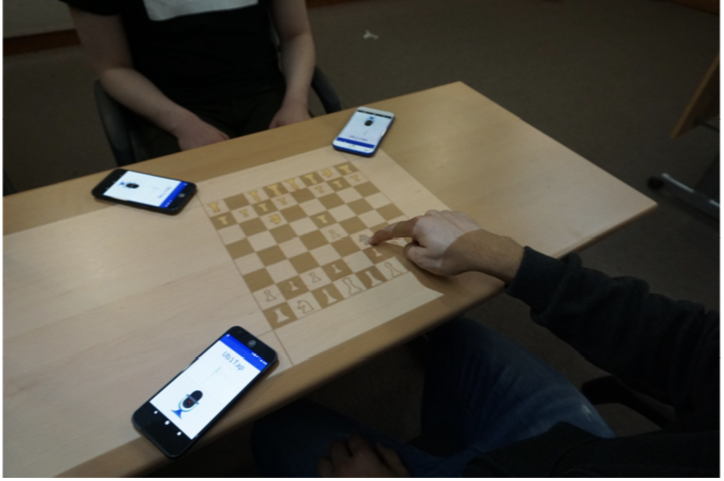
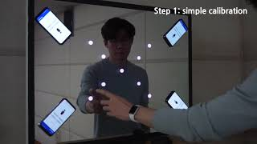
Ubitap
Use a touch screen regardless of time and place, for example, board games
Using touch screens with minimal resources, cutting down on cost and using built-in microphones in regularly used devices.

Slide 3
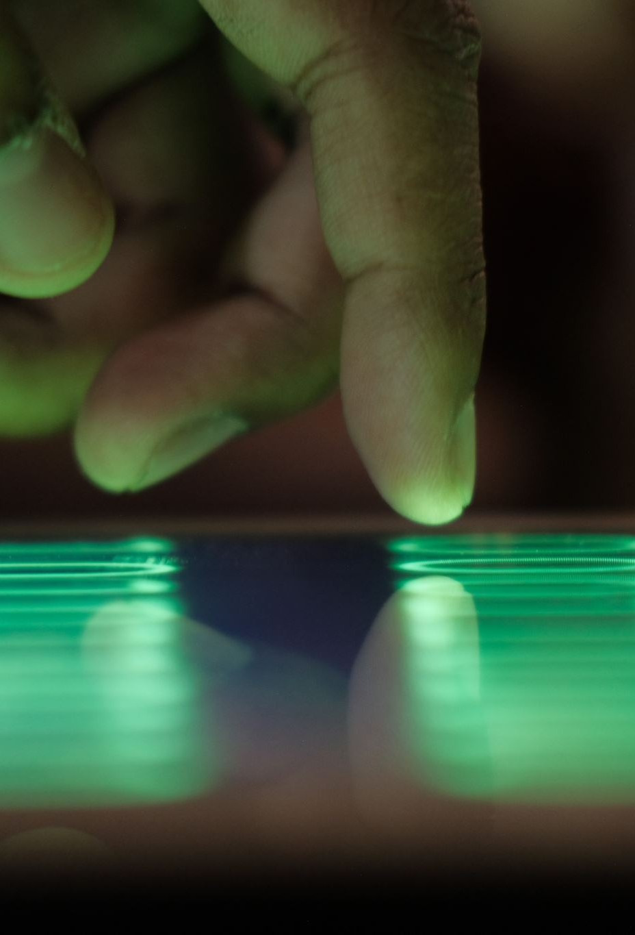
Ubitap
Most recent trend! – seamless interaction with various devices using surfaces on objects as touch surfaces.
Many previous works that have focused on tracking user’s fingertip on the surface
Ubitap is an approach that takes on surface touch inputs in a unique way: by listening to the sound, without the loss of portability.
It first records the sound using atleast 3 microphones (in-built). It then analyzes the wave and estimates the location of the sound.

Slide 4
Requirements of Ubitap
Requirements
Accuracy
Usability
Robustness
Responsiveness
Portability

Slide 5
Challenges
Variation in surfaces: Touchsound travels with different speeds on different surfaces. Users may use different surfaces depending on the environment.
Relocation of touch input space: possibility to recreate the input for touchsound on a different area of the same surface.
Changes in the surrounding environment: users may place new objects or displace already present objects which may affect reflection patterns

Slide 6
What’s lacking in current systems?
Low usability and robustness
Prior works have utilized classification-based techniques
Accuracy > usability
Classifications may not be reliable as touchsounds may change depending on the environment.
Low accuracy and portability
Prior works have utilized TDoA between microphones.
But accurate measurement of TDoA requires precise hardware with microphones, geophones, accelerometers
Lower accuracy due to dispersion

Slide 7
Acoustic Dispersion
A touchsound causes the air pressure around it to change.
Solid surfaces traverses different sound waves (of varying frequencies) at different speeds.
Acoustic dispersion: the idea that different frequency components of the touchsound pass the area near microphones at different times.
Speed of sound on solid surfaces > Speed of sound in air.

Slide 8

Key Principles
1. Different frequency components of a touchsound propagate at different speeds V(f), where f is their carrying frequency.
2. For a certain surface, V ( f ) is constant regardless of the touch location and the surrounding environment.
3. The TDoA between two different frequency components of a touchsound is linearly proportional to the propagation distance of the touchsound to a microphone (denoted as D), as follows:
$T^{A}(f_{i})$- $T^{A}\left(f_{j}\right)=D∗(\frac{1}{V\left(f_{i}\right)}−\frac{1}{V\left(f_{j}\right)})$
where $T^{A}\left(f\right)$is the arrival time of the touchsound at frequency f .

Slide 9
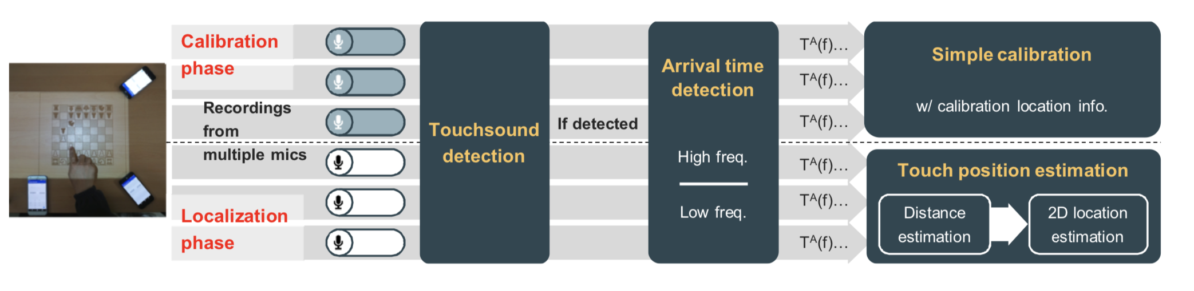
Ubitap System Architecture

Slide 10
Ubitap Design
There is an on-surface screen, and
The screen’s size and position relative to the microphones are known in advance.
Touchsounds have an energy level sufficient to analyze
Users have at least three microphones to use a distance-based localization approach

Slide 11
Touchsound detection
Ubitap uses motion sensors to overcome the problem of noise if a sound-level threshold is used.
It uses energy level of a touch sound which it compares with a threshold to detect the touch

Slide 12
Arrival time estimation
Ubitap does not use a high-resolution method to detect frequencies as it may compromise responsiveness
It differentiates between high and low frequency waves and deals separately with them.
Low-frequency waves
Arrive in the form of negative peak
Highest energy level
High-frequency waves
Are observed very early => smaller number of samples
Can use high resolution methods since sample is smaller

Slide 13
Implementation
This idea requires minimal hardware.
The prototype has been tested on Android running smartphones
Implementation includes capturing raw sensor data using microphones and gyroscopic sensors.
Configurations
Microphones with sampling rate 192 kHz
Motion sensors with sampling rate 220 kHz

Slide 14
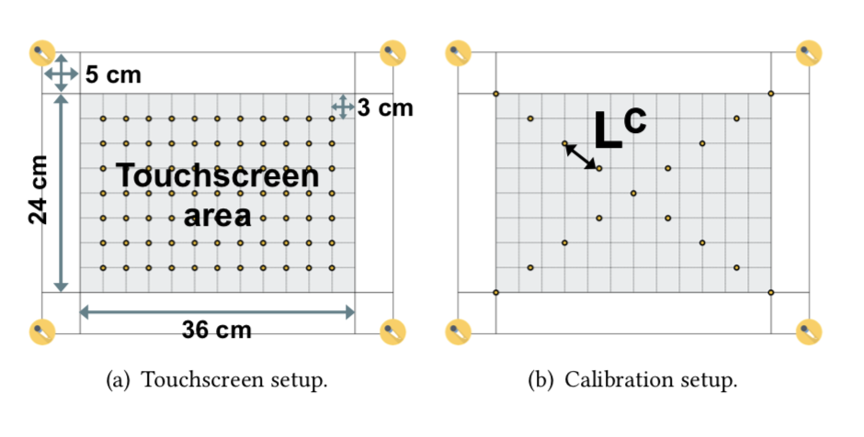
Evaluation (set-up)
On-surface touchscreen (36cm X 24cm)
Portable projector (SK Smart Beam)
Microphones of smartphones (2 Google Pixels, 2 Google Pixel XLs)
On a wooden table
Also included glass mirror and acrylic board
Requested the user to tap the calibration points

Slide 15
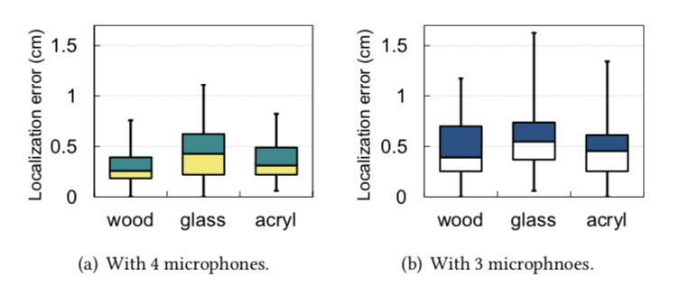
Evaluation
Accuracy test
Overall: Satisfies sub-centimeter accuracy as it captures dispersive characteristics of touchsounds
Number of microphones: Ubitap provides a great accuracy for greater number of microphones, but has also performed great with the minimal number (3 microphones)

Slide 16

Evaluation
Robustness test: inputs in dynamic environmental changes
Changes in position of touchscreen
Changes in surrounding objects
Ambient Noise
Responsive test
Running time of 33.4ms
Shows it could be useful in variety of applications
Usability test
Even lower number of calibration points provide higher degree of accuracy
Prior works trade-off between accuracy and usability

Slide 17
Potential Limitations
Curvature/irregularity in surfaces
Large obstacles
Smaller display area
Close proximity between microphones
Touch tool variations

Slide 18
References
Kim Hyosu, Anish Byanjankar, Yunxin Liu, Yuanchao Shu, and Insik Shin. "UbiTap: Leveraging Acoustic Dispersion for Ubiquitous Touch Interface on Solid Surfaces." In Proceedings of ACM Sensys, 2018.

